Slide 1
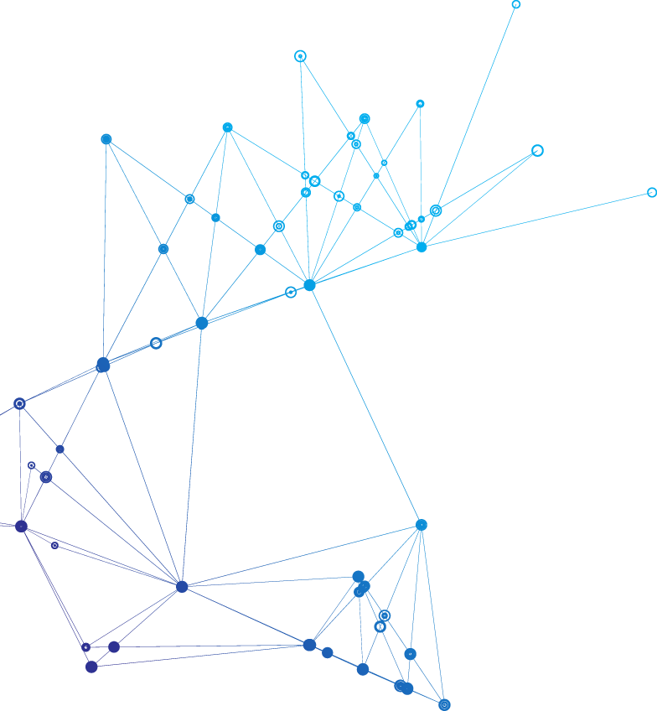
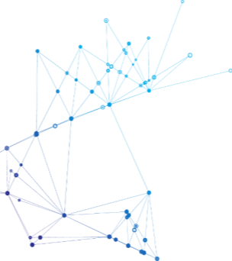
The outlook of the
Metaverse and NFT
Team 5

Slide 2
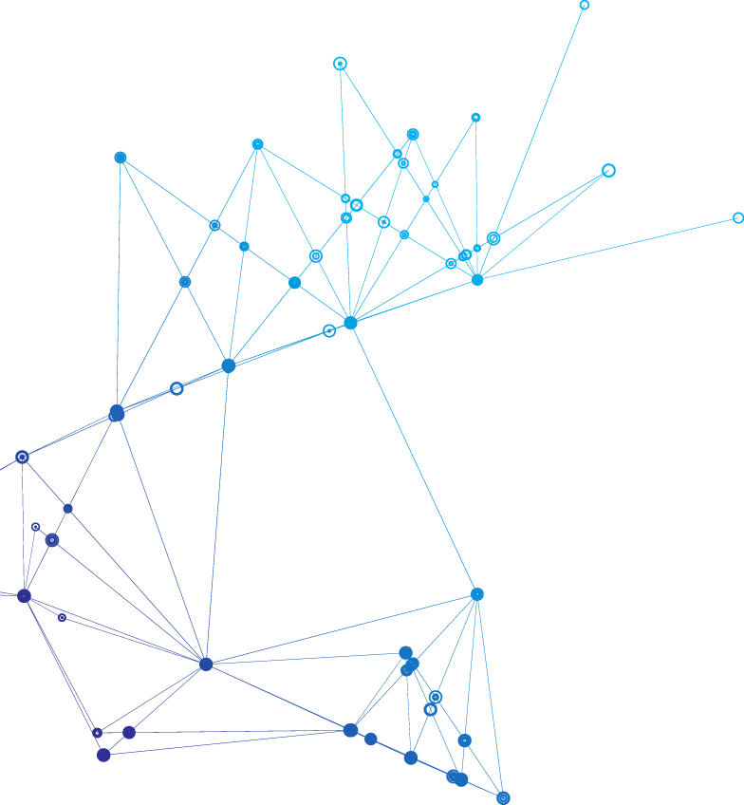

CONTENT
01
What is Metaverse
02
Metaverse industry outlook
03
Metaverse and Investing
Priyal
Hanyang Li
Poorna
04
What is NFT
05
Investing in NFT
Nanjie Yin
Varun Jain

Slide 3
1
What is Metaverse
Priyal

Slide 4
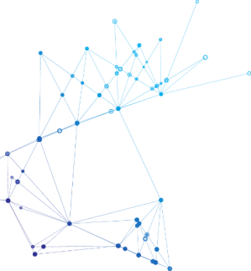
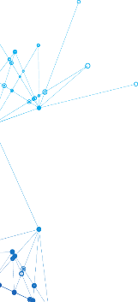
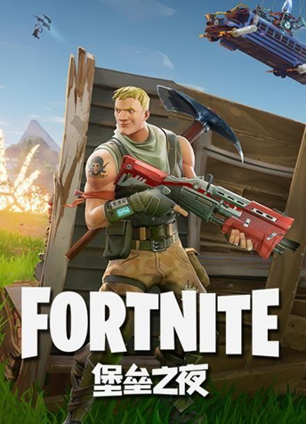
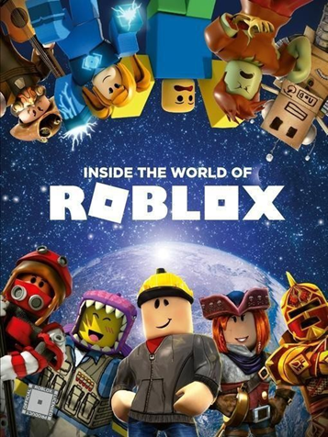
What is Metaverse ?
Metaverse is a hybrid of Augmented Reality (AR), Virtual Reality (VR), and video technologies inside a virtual forest
Accessed through a browser allowing people to have real time experiences and interactions
Metaverse has numerous disconnected metaverses
Examples of Metaverse:
Fortnite
Roblox
Nikeland
Fortnite – one of the best Metaverse examples

Slide 5
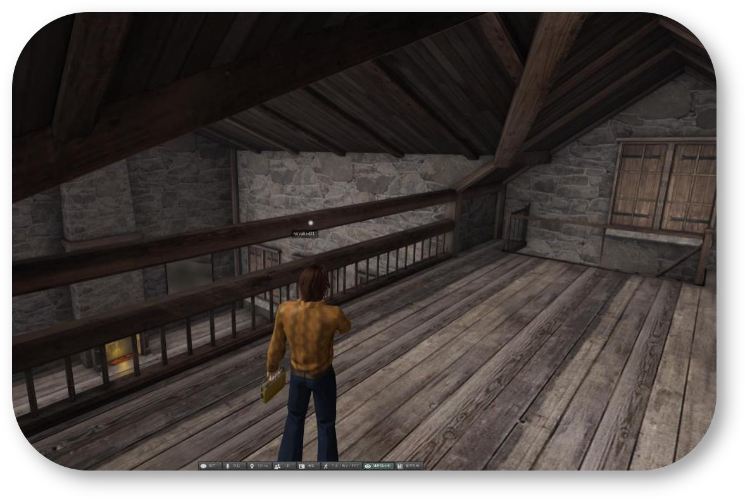
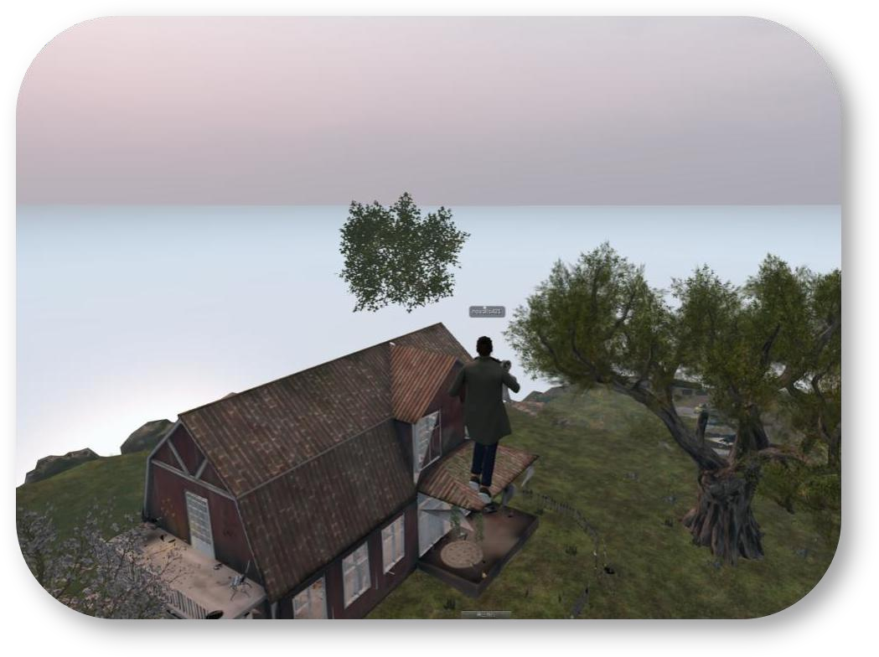
Why is Metaverse so important?
The ability to fully own virtual objects, experiences or land, with Blockchain making it possible to precisely define a virtual thing
Interconnecting worlds that are not limited by geographical boundaries
Ease of access – internet connection and the right setup
Allows for a more user immersive experience in various forms of content
Interactions of people with each other in various settings is made possible
Space-time stipulation in the real world
Surreal space-time stipulation

Slide 6
2
Metaverse industry outlook
Hanyang Li

Slide 7
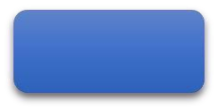
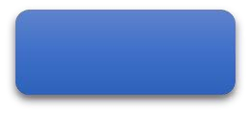
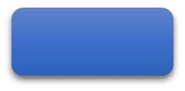
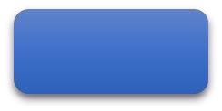
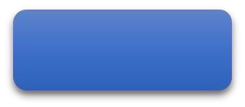
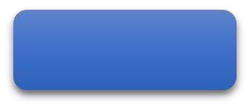
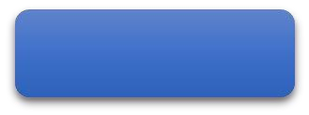
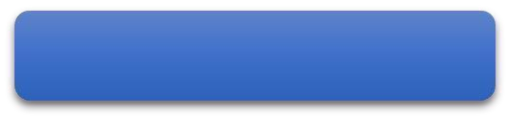
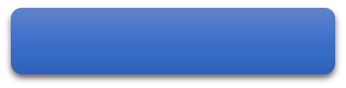
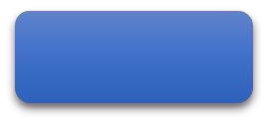
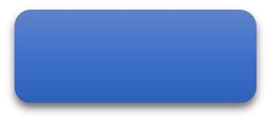
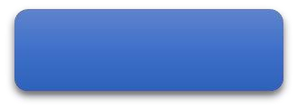


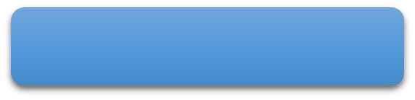
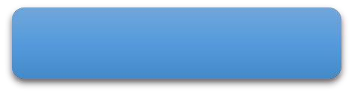
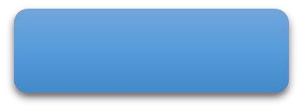
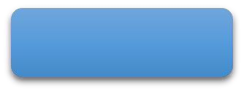
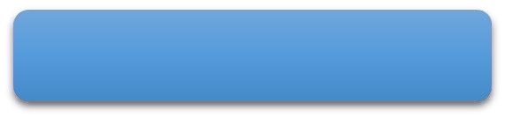
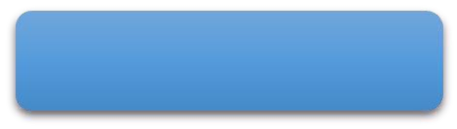
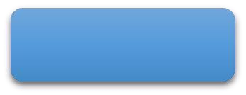
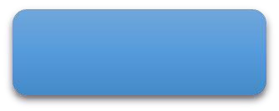

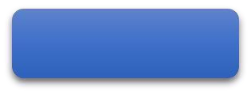
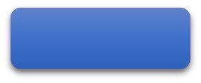
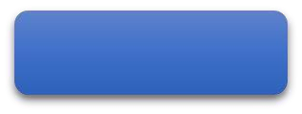
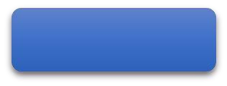
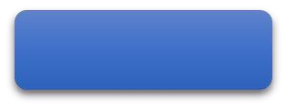
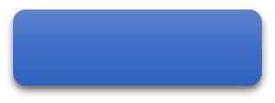
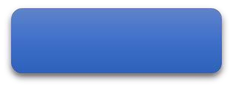
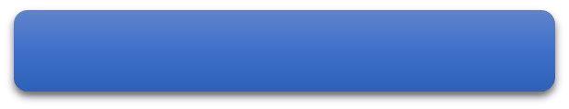
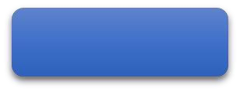
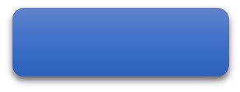
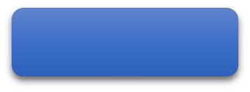
The ecological map of the Metaverse is becoming more and more mature
Scene content
Game
social
Sports
Travel
Exhibition
education
经济体系
crypto wallet and entrance
trading platform
cinema
shopping
Advertisement
……
Front-end equipment platform
touch
hand gesture
web hosting
VR、AR
AI computational entity
smart wearable
voice control
neural device
……
underlying structure
Backend infrastructure
underlying technical support
cloudification
blockchain
NFT
Virtual currency
5G
GPU
AI
Network and Computing Technology
interactive technology
Internet of things
Visualization and Digital Twins
……

Slide 8
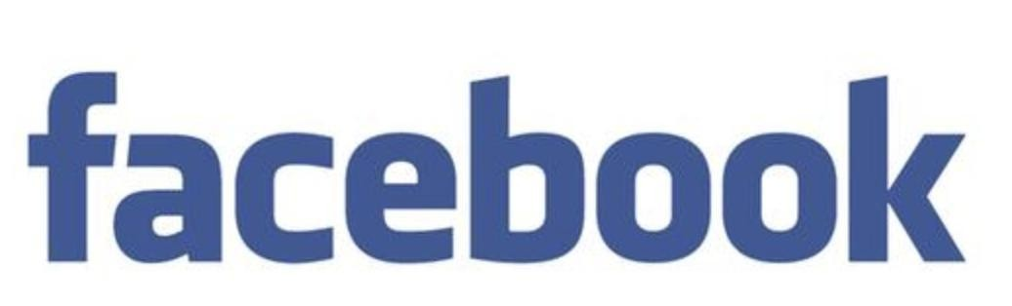
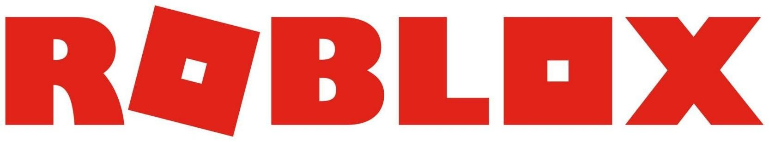
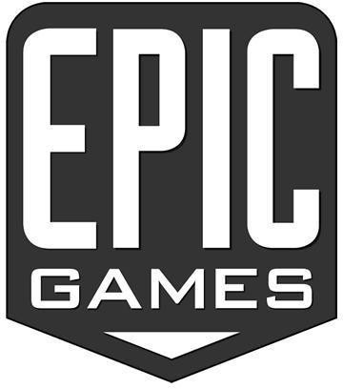
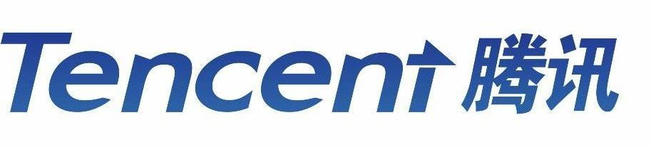
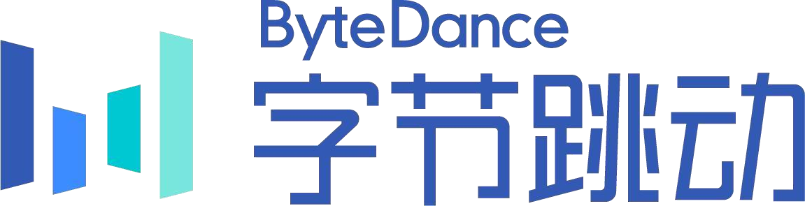
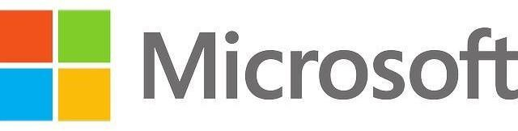
Major Metaverse companies
Facebook acquired Unit 2 Games on June 5, 2021, and has a metaverse game platform "Crayta" similar to Roblox + Fortnite
extended reality
extended reality
extended reality
Social system
image engine
Social system
image engine
Social system
image engine
UGC ecology
MMO Game
UGC ecology
MMO Game
UGC ecology
MMO Game
extended reality
extended reality
Social system
image engine
extended reality
Social system
image engine
Social system
image engine
UGC ecology
MMO Game
UGC ecology
MMO Game
UGC ecology
MMO
Game

Slide 9

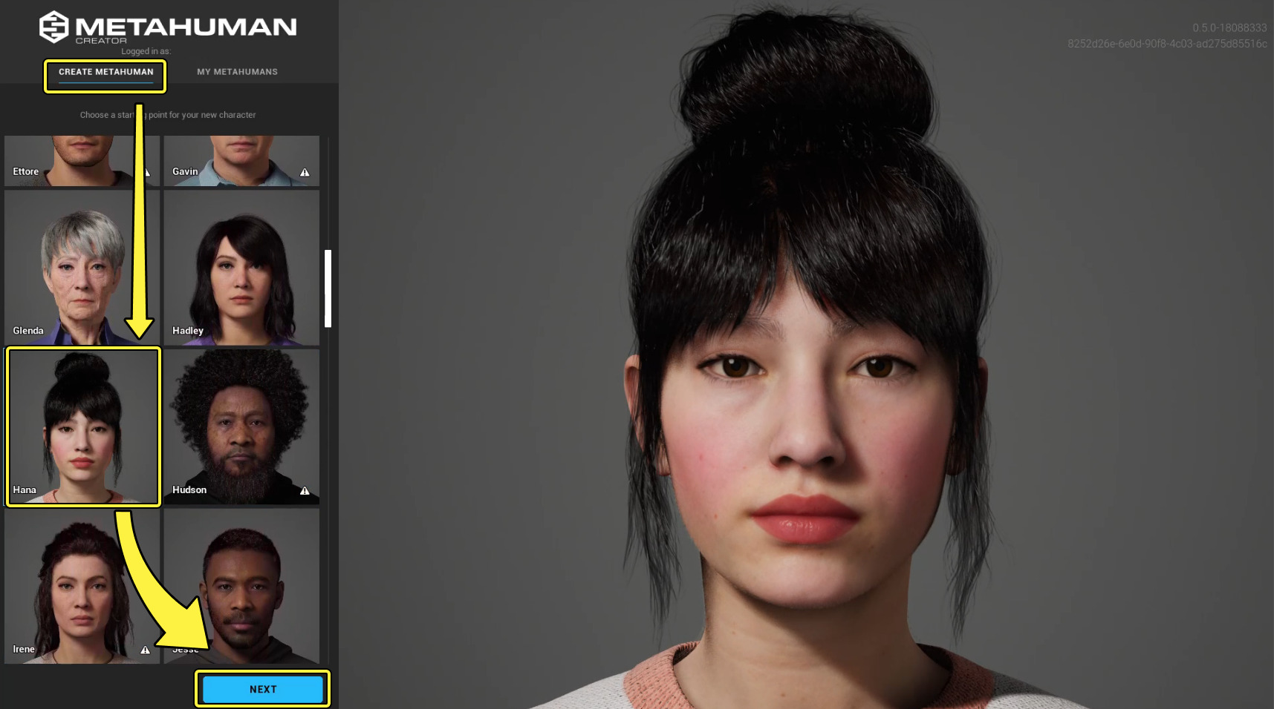
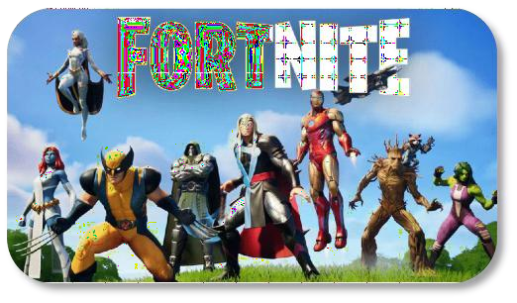
Epic Games
“Epic’s powerful technology in areas such as graphics places them at the forefront of game engine development with Unreal Engine and other innovations. ” said Sony CEO Kenichiro Yoshida.
“Epic Games' Fortnite is the "first credible metaverse" to emerge from the games industry.
We are investigating ideas around creativity and play, but not ones focused on the brick"
said Lego Ventures CEO Rob Lowe
MetaHuman Creator,
a high-fidelity digital human design platform based on cloud-based Unreal Engine
Sony invests twice in Epic Games in 2020 and 2021. And this is the third time.
According to an epic new：“ In April 11, 2022. Today Epic Games announced a $2 billion round of funding to advance the company’s vision to build the metaverse and support its continued growth.”
‘This investment will accelerate our work to build the metaverse and create spaces where players can have fun with friends, brands can build creative and immersive experiences and creators can build a community and thrive.’ said Tim Sweeney, CEO and Founder, Epic Games.

Slide 10
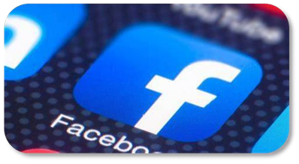
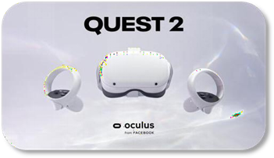


Facebook
“I think we will effectively transition from people seeing us as primarily being a social media company to being a metaverse company,” Facebook CEO Mark Zuckerberg said.
Meta Oculus is an American virtual reality technology company owned by Facebook. Facebook agreed to buy Oculus VR in March 2014 for $2 billion in cash and Facebook stock.
Libra (later known as Diem) was a permissioned blockchain-based stable coin payment system proposed by the American social media company Meta Platforms. The plan also includes a private currency implemented as a cryptocurrency.

Slide 11
3
Metaverse and
Investing
Poorna

Slide 12


Metaverse economy
The metaverse economy has been likened to an online, virtual version of the physical economy we are used to.
The metaverse economy does (or will) include a variety of activities, including:
Shopping.
Visiting attractions of all types around the world.
Attending concerts and other entertainment events.
Selling digital services and products.
Virtual real estate.
Trading collectibles as nonfungible tokens or in other formats.
Online gaming and related services

Slide 13

Investing in Metaverse
There are any number of investing opportunities tied to the metaverse. Some are out there now; others will evolve and develop over time.
Stocks of companies involved in one or more aspects of the metaverse.
Metaverse ETFs — this one is still evolving.
Investing in metaverse real estate.
Crypto, NFTs and other digital assets.

Slide 14

Companies in Metaverse
1. Metaverse Stocks
Meta Platforms Class A (ticker FB)
NVIDIA Corp. (ticker NVDA)
Unity Software (ticker U)
2. Metaverse ETF’s
Roundhill Ball Metaverse ETF (ticker METV)
Amplify Transformational Data Shrg ETF (ticker BLOK)
Fount Metaverse ETF (ticker MTVR)
Fidelity Metaverse ETF(ticker FMET)

Slide 15
4
What is NFT
Nanjie Yin

Slide 16
PART 01
PART 02
What is NFT?
Definition of NFT

Slide 17
What is NFT?
First, If you throw a $100 denomination dollar into a pile of $100 dollars, there is no difference in its essence except that the dollar numbers are different. What does that mean? It means that no matter which $100 dollar you use you will be able to buy $100 worth of goods. This is the first characteristic of homogenized tokens: they are widespread and do not transfer value in exchange.
Third, the value of $100 dollars can be split into two $50 denomination dollars, which in reality means exchanging change bills. This reflects the third characteristic of homogenized tokens:: the value can be split.
Second, all dollars have denominations, whether $100, $50, $10 ...... will have a unit of measure associated with them to constant the magnitude of their value, which is the second characteristic of homogenized tokens: the value of the substance itself is measured.

Slide 18
Definition of NFT
NFT stands for (Non-Fungible Token), which is indivisible, irreplaceable and unique.
Human speaking: an anti-copying, anti-cheating technology

Slide 19
Three properties
1、unique and value bound.
2、the value of the substance itself is not measured, and is determined by a combination of intrinsic and extrinsic.
3、the value cannot be split.

Slide 20
For example, there is only one copy of the Mona Lisa smile in the world, and although there are many other copies, the original is the only one that has the highest value (which is certainly priceless at this time). Why does the original have such a high value?
Because it is unique! It is not like traditional money where the value of each bill of a certain denomination is anchored. So the first characteristic of non-homogenized tokens: they are unique and value bound.

Slide 21
Secondly, what is the value of a portrait of the Mona Lisa? What is the value of a statue of David? More broadly, what is the value of all types of art traded on the market? There has never been a rule that dictates how they should be priced. Their value is no longer anchored, but is determined by the deeper moral, religious, and message they carry within them, as well as their external recognition in the wider marketplace. This is the second characteristic of non-homogenized tokens: the value of the substance itself is not measured, and is determined by a combination of intrinsic and extrinsic.

Slide 22
Lastly, can the Mona Lisa's portrait be taken apart and sold? Can artworks of all kinds be sold separately? In reality, it seems to be possible, but that is called damage, disassembly is bad, bad will lose value, if you need to buy and sell, please pack the whole, no retail. This is the third characteristic of non-homogeneous tokens: the value cannot be split. Similarly, when we switch to the world of cryptocurrency, the equivalent is NFT, which is a non-homogenized token.

Slide 23
5
Investing in NFT
Varun Jain

Slide 24




DIGITAL ASSETS

Slide 25

MECHANISM OF NFTS
NFTs are built and managed on a blockchain, the same digital ledger technology system utilized by Bitcoin and other types of cryptocurrencies.
NFTs are usually based on the Ethereum (CRYPTO:ETH) network, but there are other blockchains some NFTs use as well, such as Solana (CRYPTO:SOL) and Polkadot (CRYPTO:DOT).

Slide 26


Slide 27

MECHANISM OF NFTS
NFTs are bought and sold via a NFT marketplace.
These marketplaces can be used to buy an NFT at a fixed price or function as a virtual auction.
Top NFT marketplaces include OpenSea, Rarible, SuperRare, and Foundation. Other niche marketplaces that specialize in particular assets are for example, NBA Top Shot is owned by the National Basketball Association and sells clips of player performances as NFTs.

Slide 28

MECHANISM OF NFTS
A wallet needs to be funded with the crypto needed to buy a targeted NFT.
To sell a digital asset you own, the NFT will need to be uploaded to your marketplace of choice, provided that marketplace supports the blockchain the NFT was built on.
You can choose to list it for sale at a set price or opt for an auction-style sale in which buyers place bids.

Slide 29
Work Cited
Part 1:
https://www.forbes.com/sites/deborahlovich/2022/05/11/what-is-the-metaverse-and-why-should-you-care/?sh=552555b02704
https://www.adcore.com/blog/what-are-meta-verse-examples/
https://cyberscrilla.com/the-importance-of-the-metaverse-explained/
Part 2:
https://coinyuppie.com/eight-typical-application-scenarios-of-metaverse/
https://docs.metahuman.unrealengine.com/en-US/overview/
https://www.epicgames.com/site/en-US/news/sony-and-kirkbi-invest-in-epic-games-to-build-the-future-of-digital-entertainment
https://www.gamesindustry.biz/lego-ventures-fortnite-is-the-first-credible-metaverse
https://www.tipranks.com/news/sony-invests-250m-for-minority-stake-in-fortnite-maker-epic-games
https://www.cnbc.com/2021/07/26/facebook-creates-exec-team-to-work-on-metaverse.html
https://en.wikipedia.org/wiki/Diem_(digital_currency)
https://zh.wikipedia.org/zh-cn/Oculus

Slide 30
Work Cited
Part 3:
https://academy.yellowcard.io/topics/nfts-and-the-metaverse/?utm_source=techcabal&utm_medium=article%20&utm_campaign=something_bigger
https://www.thinkadvisor.com/2022/05/24/investing-in-the-metaverse-what-you-need-to-know/
https://www.forbes.com/advisor/investing/cryptocurrency/nft-non-fungible-token/
Part 4:
Part 5:
https://finbold.com/guide/how-to-invest-in-metaverse/
https://www.google.com/search?q=Investing+NFTS&rlz=1C1VDKB_enIN1021IN1021&source=lnms&tbm=isch&sa=X&ved=2ahUKEwj3sIq50Lj6AhXWEFkFHX4TAHoQ_AUoAnoECAIQBA&biw=1440&bih=749&dpr=2#imgrc=Yg7A_i_W2blVnM

Slide 31
Thank You
Team 5

